Slide 1
The Other is Me
Yvonne Bromberg, Gretchen Gaskins, Maria Mavrokostidou, Bettina Pope

Slide 2
Recommended Courses: Holocaust & Genocide, Word Literature, English, World History, U.S. History, AP European, Art, Humanities, Special Topics, Social Studies
Primary Category: Holocaust, Inclusion, Diversity
Context: (Holocaust Studies) Focus on the history of the Holocaust via interaction and communal experience.
Goals: To develop civil rights awareness, communal memory, respect, and understanding, interpretation of material culture, speaking and oral presentation skills, group collaboration.

Slide 3
Essential Question(s):
How can examining viewpoints that are different from our own help us explain the actions of others?
How can looking at multiple points of view help us explain the ideas and actions of individuals and groups?
Objective(s):
(TEKS)
(1) Social studies skills. The student uses problem-solving and decision-making skills, working independently and with others, in a variety of settings. The student is expected to:
(A) apply social studies methodologies encompassing a variety of research and analytical tools to explore questions or issues thoroughly and fairly to include multiple perspectives;
(D) examine the role of diverse communities in the context of the selected topic;
(2) Social studies skills. The student applies critical-thinking skills to organize and use information acquired from a variety of valid sources, including electronic technology. The student is expected to: (A) locate, analyze, organize, synthesize, evaluate, and apply information about the selected topic, identifying, describing, and evaluating multiple points of view; (C) read narrative texts critically and identify points of view from the historical context surrounding an event and the frame of reference that influenced the participants; (D) analyze information by sequencing, categorizing, identifying cause-and-effect relationships, comparing, contrasting, finding the main idea, summarizing, making generalizations and predictions, and drawing inferences and conclusions; (E) collect visual images (photographs, paintings, political cartoons, and other media) to enhance understanding and appreciation of multiple perspectives in a social studies topic;
(3) Social studies skills. The student creates written, oral, and visual presentations of social studies information. The student is expected to: (C) use appropriate oral communication techniques; (F) use visual images (photographs, paintings, and other media) to facilitate understanding and appreciation of multiple perspectives in a social studies topic;

Slide 4
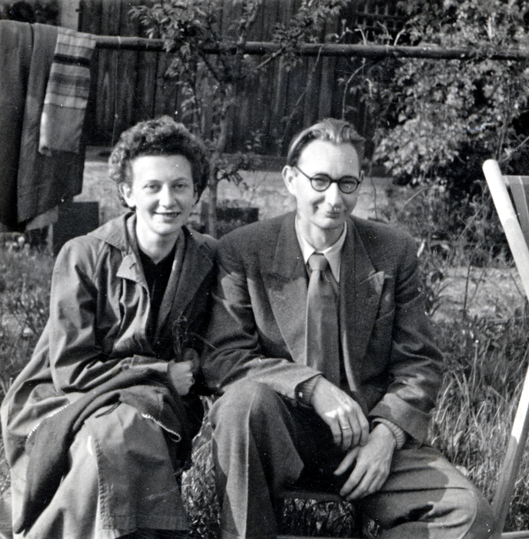
Materials needed:
*Lilli Tauber interview excerpt and video
* Personal objects/artifacts
* Partner classroom with video conference capabilities, website builder (ex: Google Sites), film guiding questions.

Slide 5
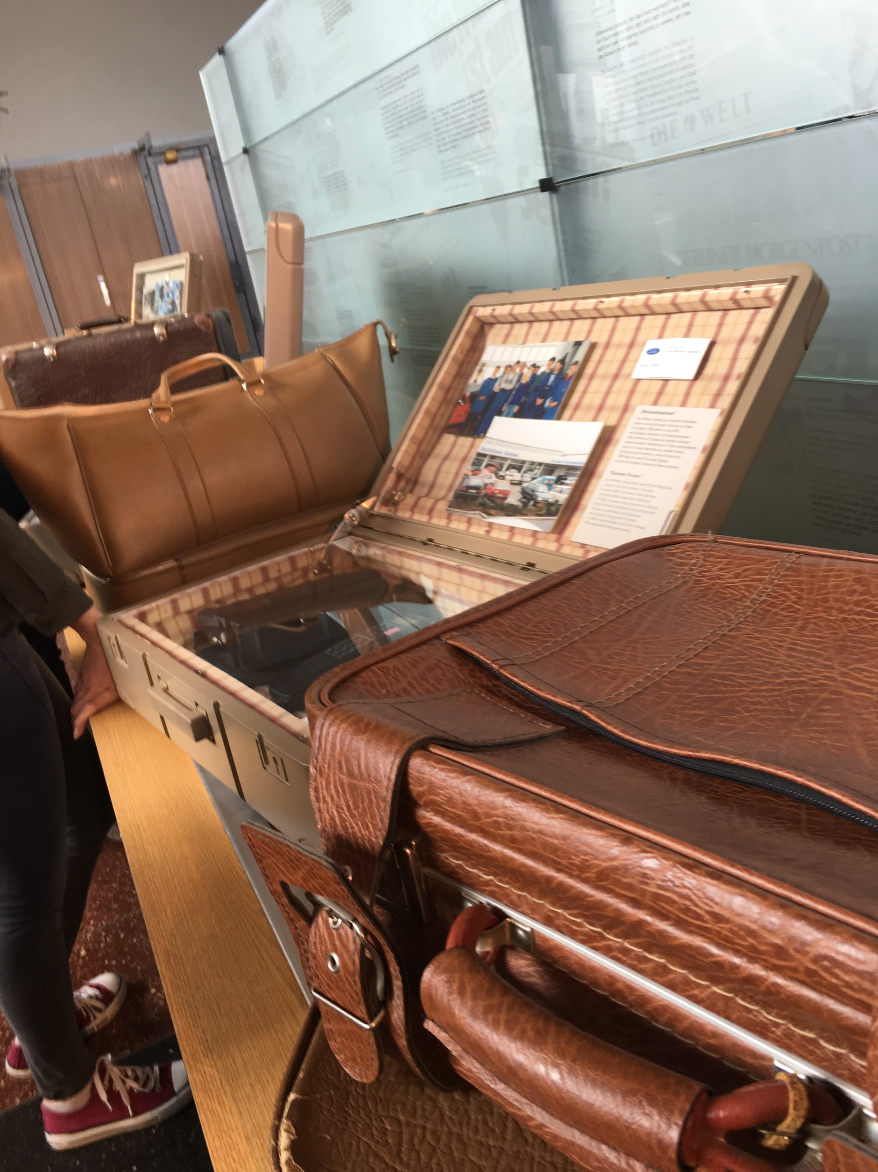
The Lesson:
“The Other is Me. Sometimes we are different. Sometimes we are the same, but we are always worth the same.”

Slide 6
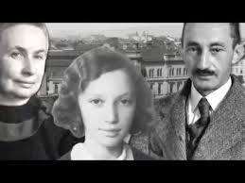
My brother fled to Palestine with an illegal transport in October 1938. After that I never saw him again. Traveling was expensive and we both didn’t have enough money to travel after the war.
No one cared about school anymore. Uncle Gottfried had connections with the Bnei Brit lodge, a Jewish social organisation. Bnei Brit means ‘Children of the Covenant’, and those lodges exit all across the globe. Back then they helped to save the lives of Jewish children.
The proceeding was such that someone had to guarantee that the child wouldn’t be a burden to the British state. Children who had such a guarantee received a permit and were allowed to emigrate to England with a Kindertransport but without their parents. There were girls, boys and even babies in these Kindertransports – it’s hard to imagine what it was like today.
No one ever told me that my parents would follow me to England, but I never gave up hope they would.

Slide 7
Students are to reflect on the film and write a response to the following question:
If put in a situation where they must leave quickly, unsure if they will ever return, what one object will the bring and why?
Exit Ticket
Journal
Reflective Paragraph
Students will bring in objects and discuss the relevance of the object in small groups.
Groups will choose one object per group to be sent to partner classroom
Depending on class size and time frame, all objects may be sent
Objects and Student Reflections are sent to Partner Classroom
If sending by post presents a problem, items can be sent virtually.

Slide 8
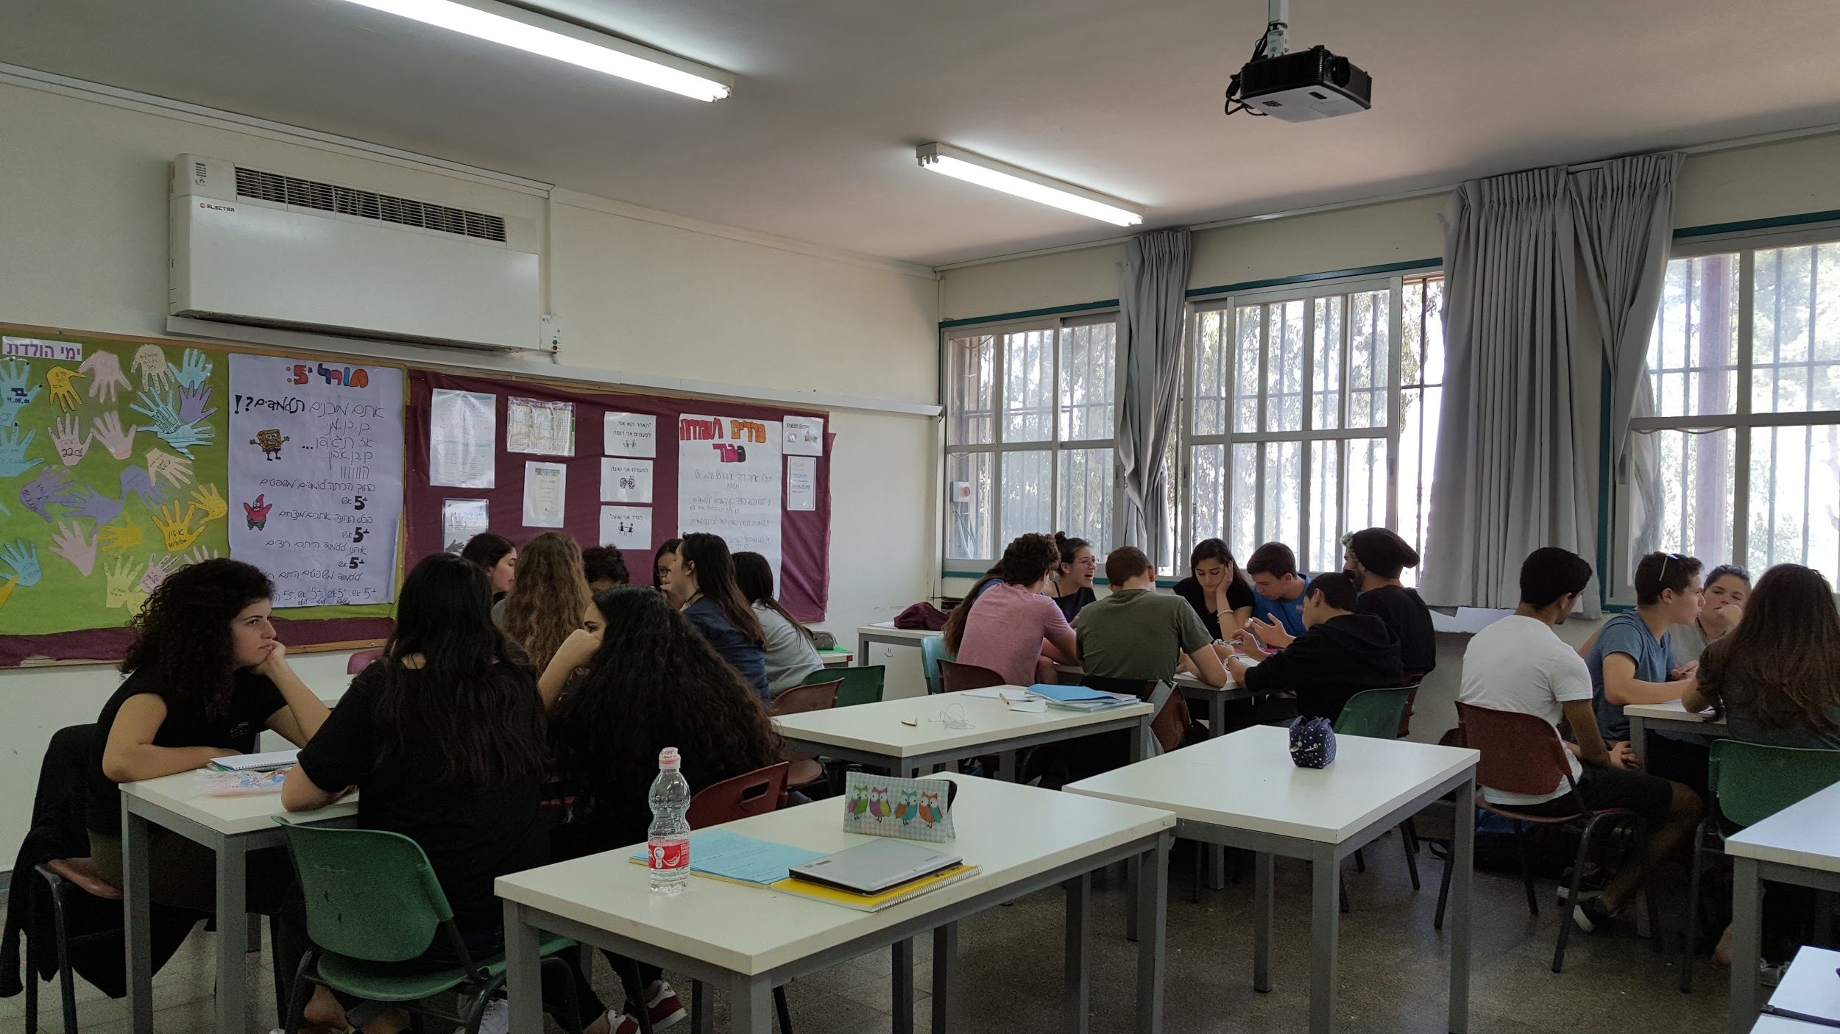
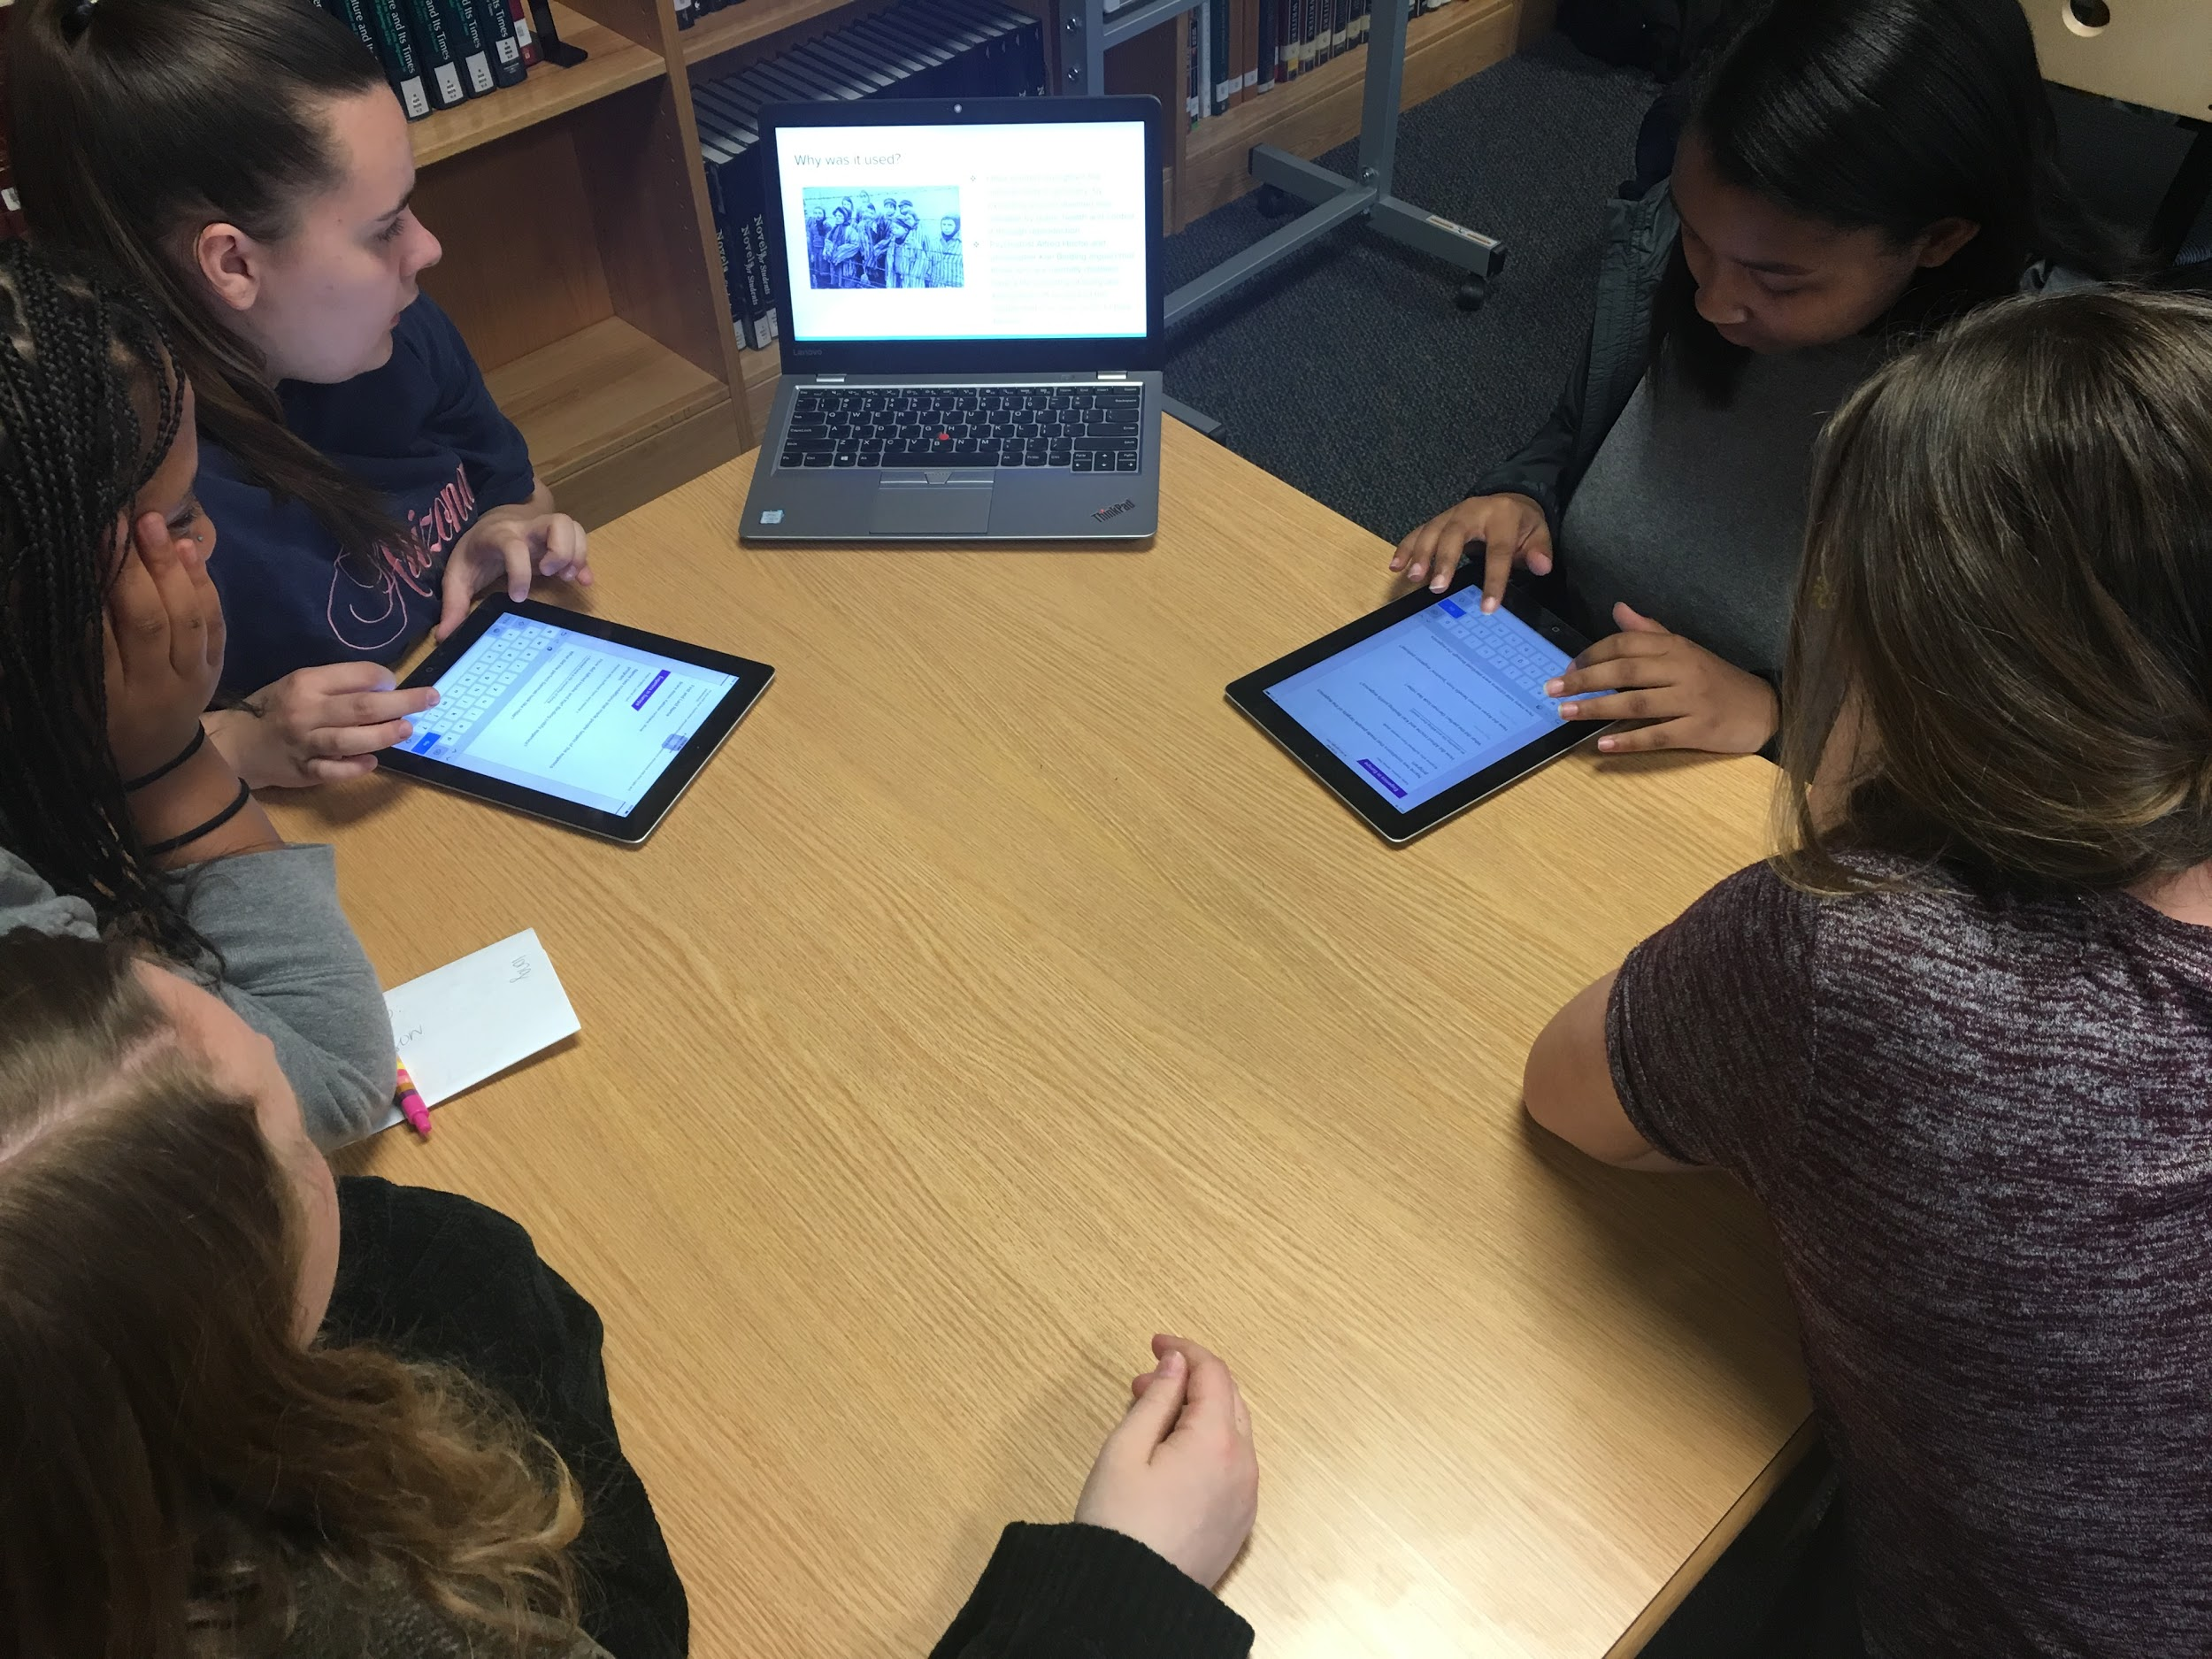
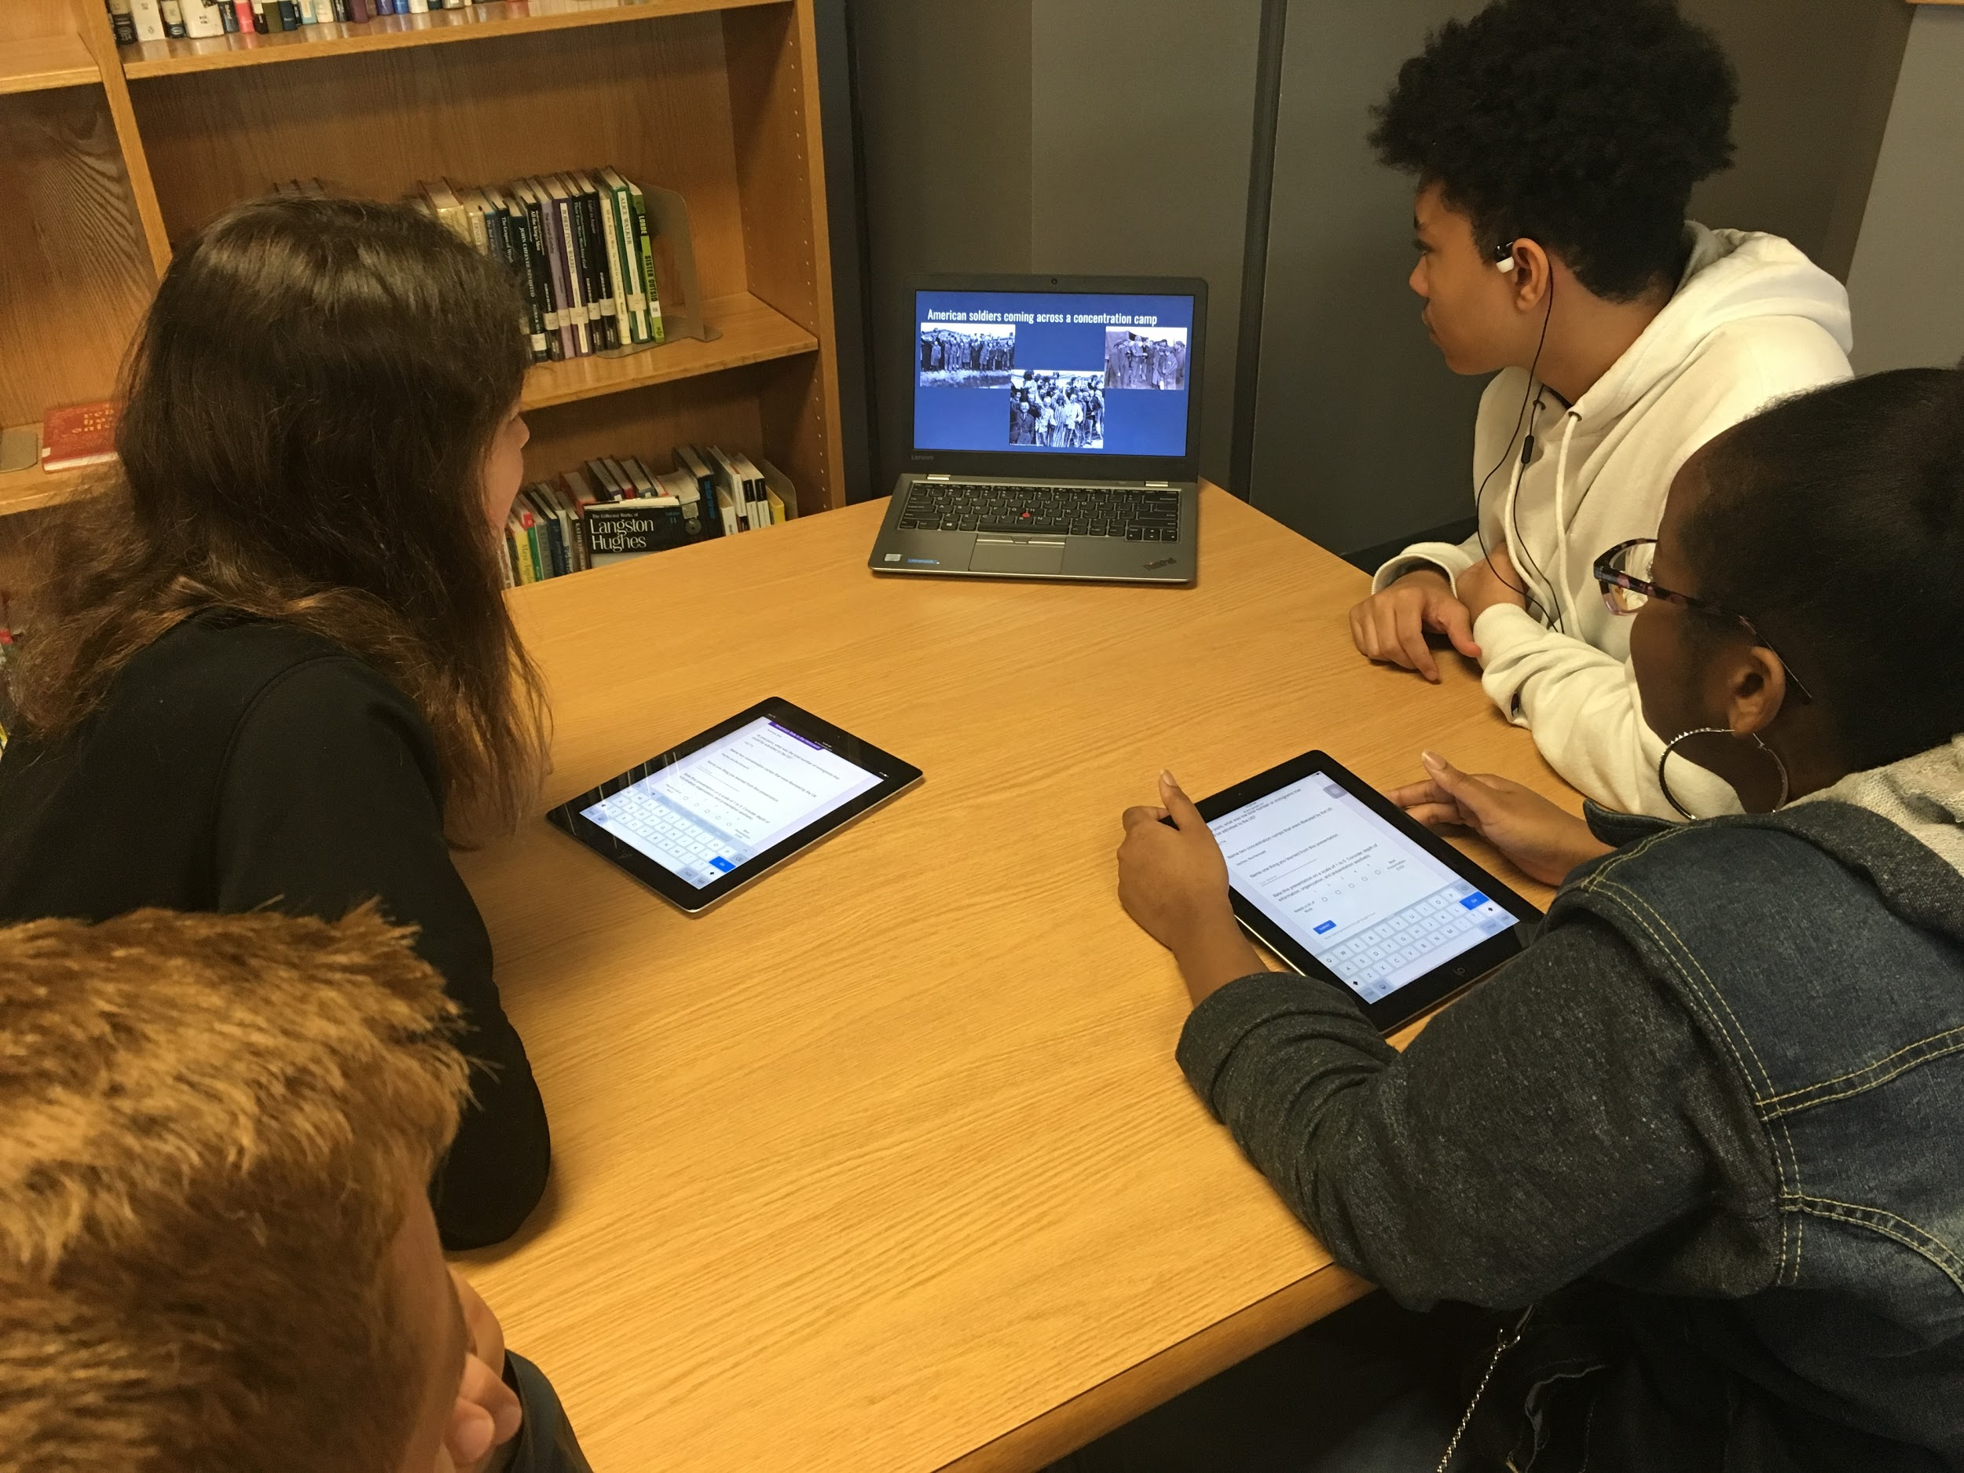
The Unpacking:
Students will analyze the objects using the guiding questions as a reference and record their answers in written form. (paragraph, journaling, Exit ticket, etc)
Describe the object (material, category)
Create a profile of the object’s owner
Why do you think he/she chose this object?
Would this be an object you would consider packing, why or why not?
Students will cross reference the text: the original owner’s explanation & their own interpretation. Students will look to draw similarities and differences between themselves and students from the partner classroom.

Slide 9
The
Other
Is
Me
Reintroduce the quote, “The Other is Me . . . “.
Students will discuss the meaning of this quote once more now that they have analyzed the objects of students from a different background, geographical location, socioeconomic status, etc.
Connect to how not viewing “The Other is Me” can lead to events such as those that occurred in the life of Lily Tauber.

Slide 10
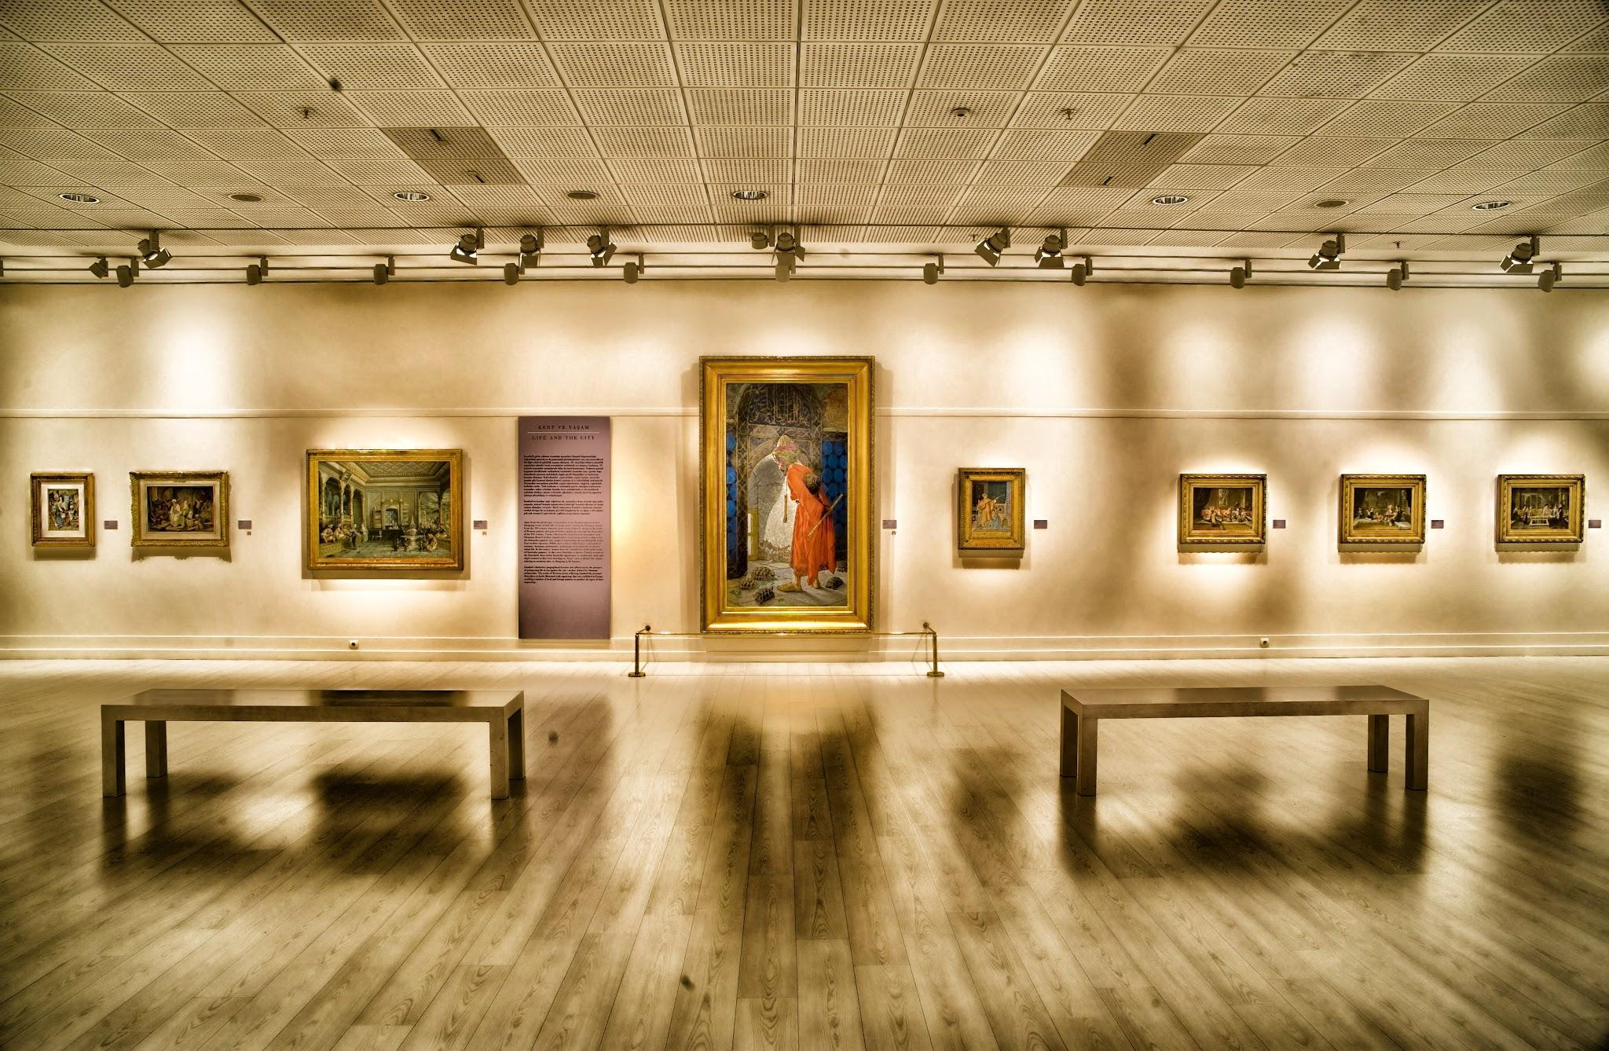
Students serve as curators as they display and explain the objects from their partner classroom. This can be done on a subject, grade, and/or school level. This can be done as a Live Exhibition or as a Digital Exhibition.
Exhibition Instructions
Take photos of the objects
Upload photos
Add both texts concerning the object (the interpretation)
Add the interview and film about Lily Tauber
Class reflection “How has this project changed your personal perception of “the other”? (Class Blog, quotes, Word Cloud, artistic interpretation, etc.)

