Slide 1
Notes:
https://imgur.com/r/quotesporn/XVbrXO2

Slide 3
World Geography in South Carolina
WG-5.2 Classify and describe the spatial distribution of major economic systems, including traditional, command, and market economic systems (e.g., North Korea’s command economy as opposed to Germany’s market economy).
WG-7.1 Explain how cooperation and/or conflict can lead to the control of Earth’s surface (e.g., the establishment of new social, political, or economic divisions).
WG-7.2 Explain the causes of boundary conflicts and internal disputes between culture groups (e.g., the ongoing Israeli-Palestinian conflict).
WG-7.3 Explain why political boundaries such as national borders or political districts change (e.g., those of historic imperial powers).

Slide 4
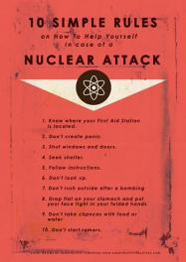
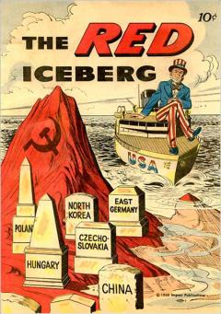
Notes:
Fallout shelter image- http://jackochikatana.com/fallout-shelters-near-me/extraordinary-design-ideas-fallout-shelters-near-me-13-surviving-a-nuclear-attack-with-spam-and-other-images-from-cold-on-tiny-home/
Duck and Cover- http://theweek.com/articles/447885/nuclear-bomb-exploded-downtown-washington-what-should
What to do in case of a nuclear attack- http://cargocollective.com/Superlectricindustries/Duck-and-Cover-zine-project-with-Daniel-Nunnan

Slide 6
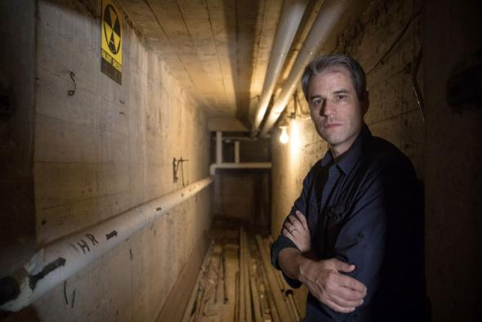
Cold War in the Landscape Today
Notes:
School fallout shelter image- https://www.stripes.com/news/us/school-fallout-shelter-untouched-for-55-years-might-come-in-handy-now-1.493115
Fallout Shelter Sign- https://www.groupon.com/deals/gs-official-government-issue-1960-s-vintage-fallout-shelter-sign-limited

Slide 7
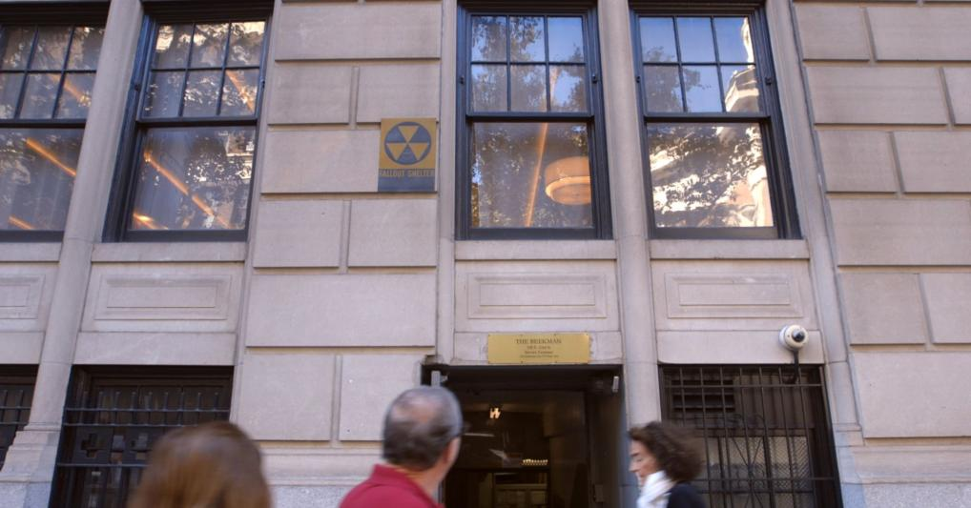
Notes:
https://www.cnbc.com/2017/10/06/thinking-the-unthinkable-dont-rely-on-these-historic-fallout-shelters-in-case-of-a-nuclear-attack.html

Slide 8
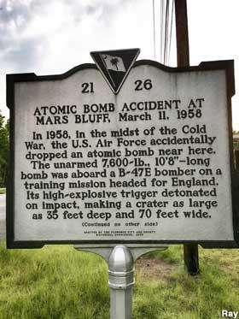
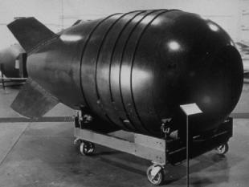
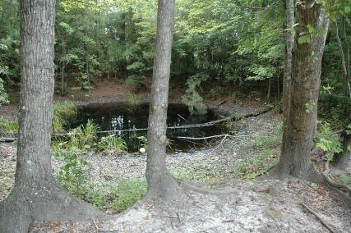
Notes:
Mars Bluff- https://www.roadsideamerica.com/story/24951 (Atomic Bomb Dropped Here)
Mk6 Nuclear bom- https://en.wikipedia.org/wiki/1958_Mars_Bluff_B-47_nuclear_weapon_loss_incident
Mars Bluff Crater- https://www.atlasobscura.com/places/mars-bluff-crater

Slide 9
US History and Constitution
USHC-7.5 Analyze the impact of the Cold War on national security and individual freedom, including the containment policy and the role of military alliances, the effects of the “Red Scare” and McCarthyism, the conflicts in Korea and the Middle East, the Iron Curtain and the Berlin Wall, the Cuban missile crisis, and the nuclear arms race.
Notes:
Stanford History Education Group- https://sheg.stanford.edu/history-lessons/cold-war

Slide 10
How and Why did Europe become divided by the “Iron Curtain?”

Slide 11
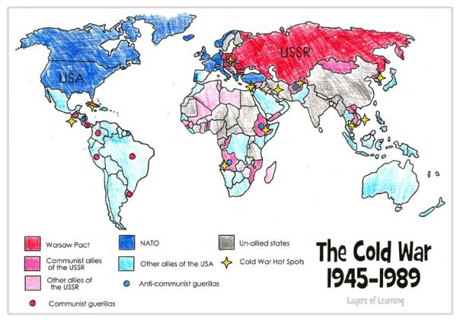
Notes:
Layers of Learning- https://layers-of-learning.com/cold-war-map-world/
What is NATO? Which countries were involved in NATO? Does it still exist?
What is the Warsaw Compact? Which countries signed the compact? Does it still exist?
Look up one or two of the counties where Communist or anti-communist guerrillas were operating. What happened there?
The “Cold War Hot Spots” are places where actual armed conflicts broke out. Learn about one or two of these hot wars during these time periods by looking up the history of the country. Most people have at least heard of the Korean and Vietnam Wars, but did you know there was a war in Angola as well?
Why did so many countries get involved in a conflict that we essentially between the United States and the Soviet Union? What was it all about?
The US and USSR were allies during WWII, so why did they end up enemies so quickly afterward?

Slide 12
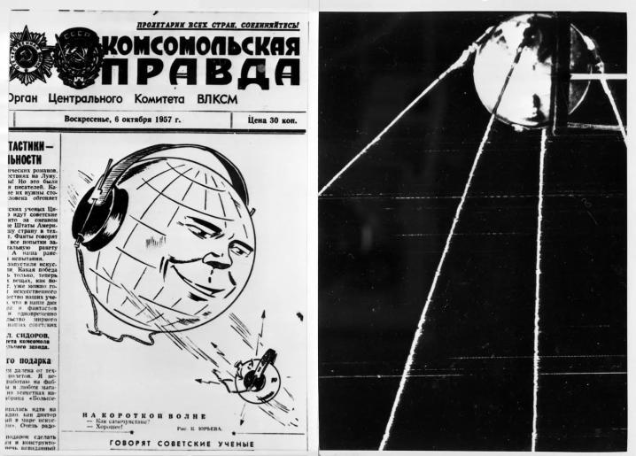
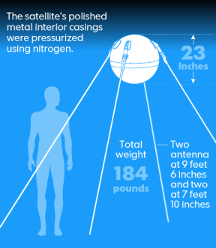
Notes:
(l) https://www.usatoday.com/story/tech/science/2017/10/04/sputnik-first-man-made-satellite-launched-60-years-ago-today-soviet-union/730629001/
(r) http://www.newsweek.com/russia-space-60-years-moscow-launched-earths-first-manmade-satellite-677258

Slide 13
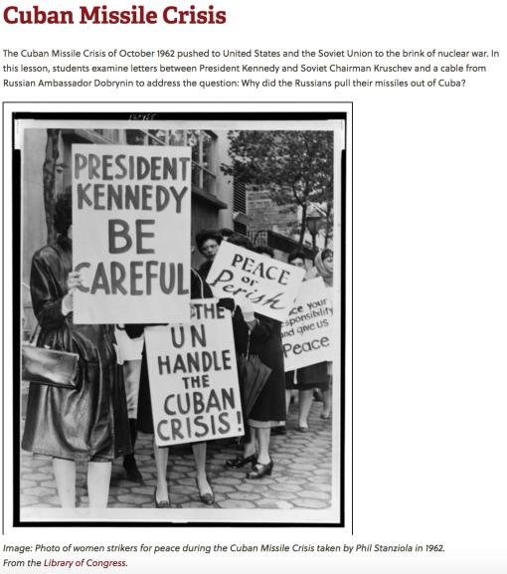
Why did the Russians pull their missiles out of Cuba?
Introductory Video
Documents
Document A: Letter From Chairman Khrushchev to President Kennedy
Document B: Letter from President Kennedy to Chairman Khrushchev
Document C: Russian Ambassador Cable to Soviet Foreign Ministry
Guiding Questions for Each Document
Notes:
https://sheg.stanford.edu/history-lessons/cuban-missile-crisis

Slide 14
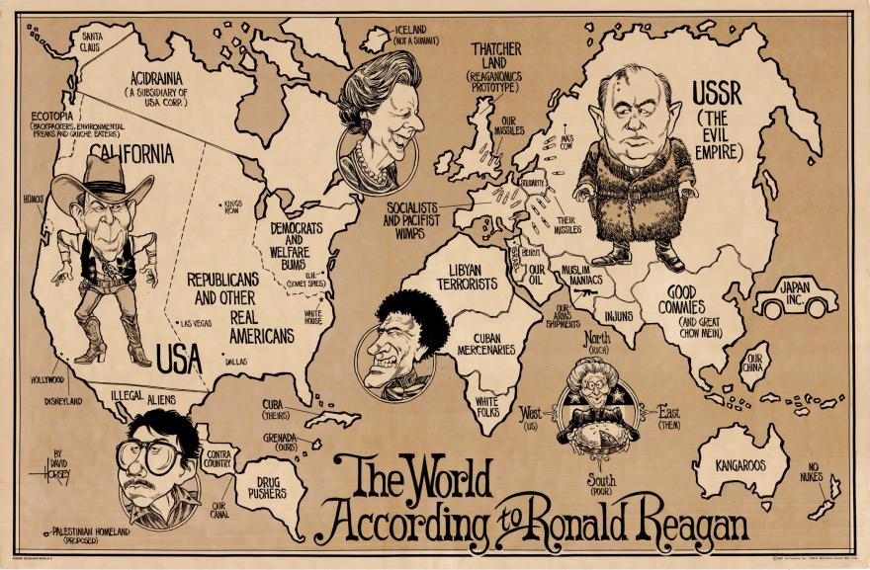
Notes:
https://bostonraremaps.com/inventory/1987-world-ronald-reagan/

