Slide 1
Centropa – „Jumping Borders Project“
A Project in cooperation with Marie Kahle Gesamtschule (Bonn, Germany)
Presenter at CSA 2018: Phillip Goebbels

Slide 2
What was needed?
Project day on the 27th of January (Memorial Day for the Victims of National Socialism)
Every grade needs ist own topic
8th grade (12-14 years)

Slide 3
Centropa‘s material & connection
Film: Survival in Sarajevo: Friendship in time of war.
http://www.centropa.org/de/centropa-cinema/prezivjeti-u-sarajevu-prijateljstvo-za-vrijeme-rata?language=en
Exhibition:
„La Benevolencia“‘s activity in Sarajevo during the civil war
Film: History and living in Sarajevo
A film created by Asmir Hasicic and his students of „Malta“ School, Sarajewo, after K. Lakeberg (Marie Kahle Gesamtschule) and A. Hasicic got to know each other at the Centropa Summer Akademie.

Slide 4
What we got!
1. Bonn-Sarajevo Jumping Borders Project (2013)
Partner – student exchange:
Elementary school „Malta“ Sarajevo
Marie Kahle Gesamtschule Bonn
Based on:
cultural exchange
Bosnia-Germany friendship
Centropa movie Survival in Sarajevo: Friendship in time of war.
2. Project day (27.1.)
Exhibition
Film (Centropa and Elementary school „Malta“ Sarajevo)
A lot of material to work with;)
http://www.centropa.org/de/teaching-materials/uberleben-sarajewo

Slide 5
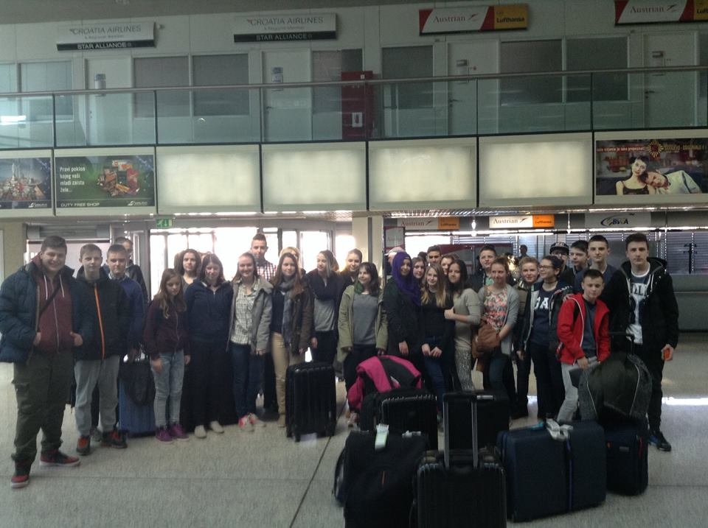
Students getting to know each other
First Contact via Skype
Following connections via Facebook
Exchange
Sarajevo – Bonn
Bonn – Sarajevo

Slide 6
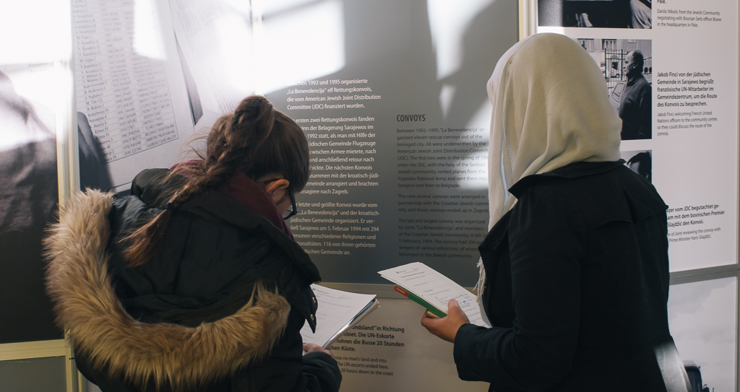
Project day (27.1)
Exhibition
Introduction (picture of the exhibition “Surviving in Sarajevo”)
2. Sarajevo - getting to know the history of the city (Film)
3. “Courage“ in Sarajevo and Bonn
Discussion based on several pictures, factsheets with exercises
4. Surviving in Sarajevo
Exhibition about ‘La Benevolencia’ in Sarajevo
5. Surviving in Sarajevo. Sarajevo: Friendship in time of war
PPP about Jewish community in Sarajevo and ‘La Benevolencia’
Worksheet “Interviewing an picture”
each lesson about 90 minutes
Letter to a picture

Slide 7
Material:
Lessons:
http://www.centropa.org/de/teaching-materials/uberleben-sarajewo
Film:
http://www.centropa.org/de/centropa-cinema/prezivjeti-u-sarajevu-prijateljstvo-za-vrijeme-rata?language=en

